Slide 1
Work Progress
By: Abdur Rehman

Slide 2
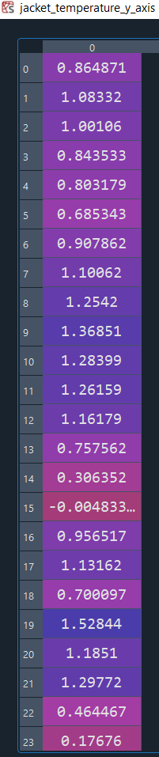
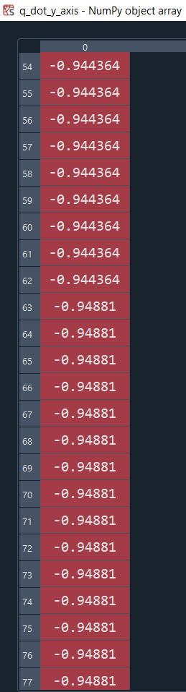
DEFINING A NEW CONSTRAINT IN PGNN
Convert the Closed Loop Array into Numpy Array
closed_loop_NParray = np.array(closed_loop_NParray)
Take the Temperature of the Jacket out from the Closed Loop Array
jacket_temperature_y_axis = closed_loop_NParray[:,3]
Take the Q_dot out from the Closed Loop Array
q_dot_y_axis = closed_loop_NParray[:,23]
The graph of both elements have been plotted in the next slide
PS the data retrieved is for the Testing set (594,24)

Slide 3
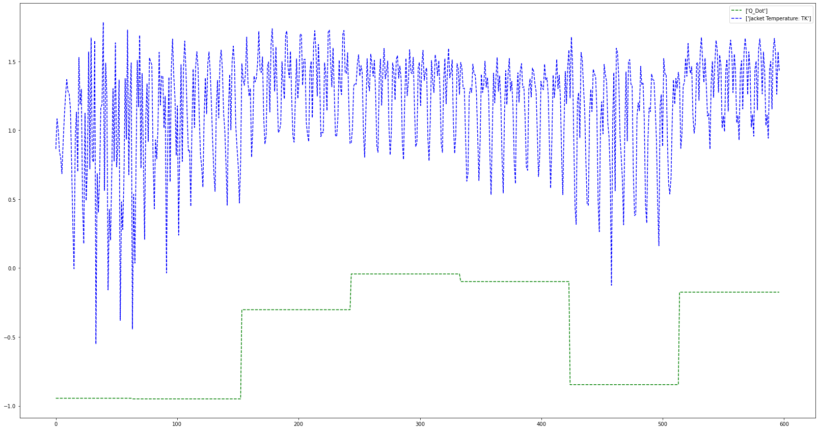

Slide 4
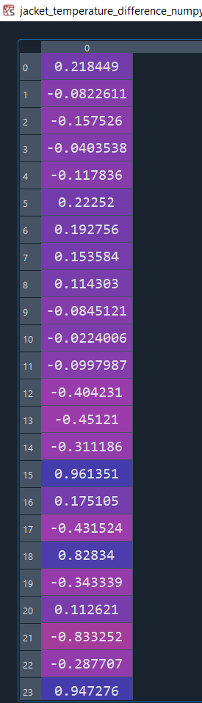
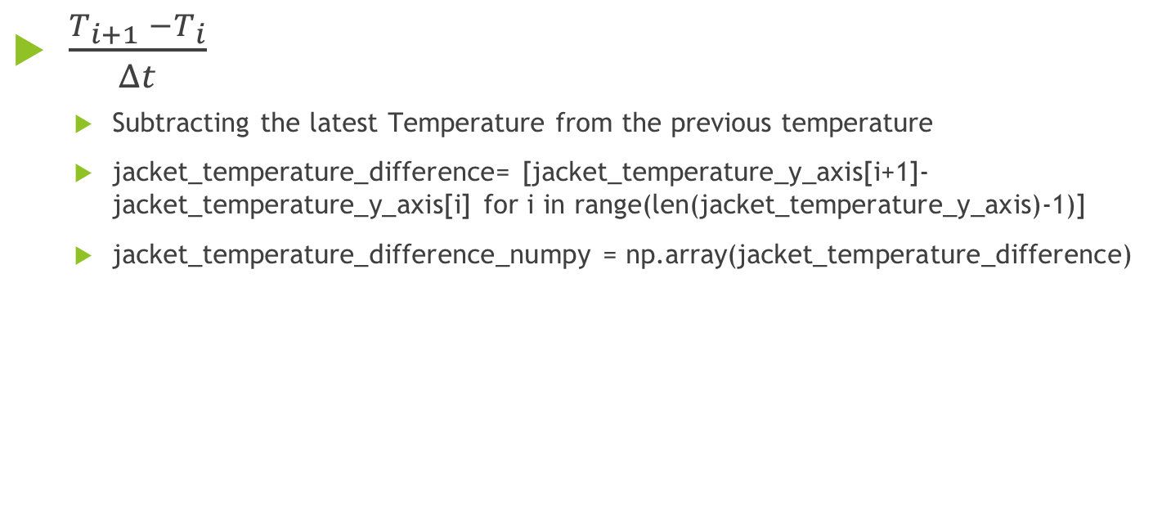
$\frac{T_{i+1} −T_{i}}{Δt}$
Subtracting the latest Temperature from the previous temperature
jacket_temperature_difference= [jacket_temperature_y_axis[i+1]-jacket_temperature_y_axis[i] for i in range(len(jacket_temperature_y_axis)-1)]
jacket_temperature_difference_numpy = np.array(jacket_temperature_difference)

Slide 5
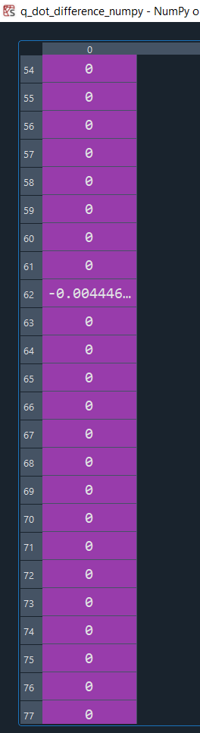
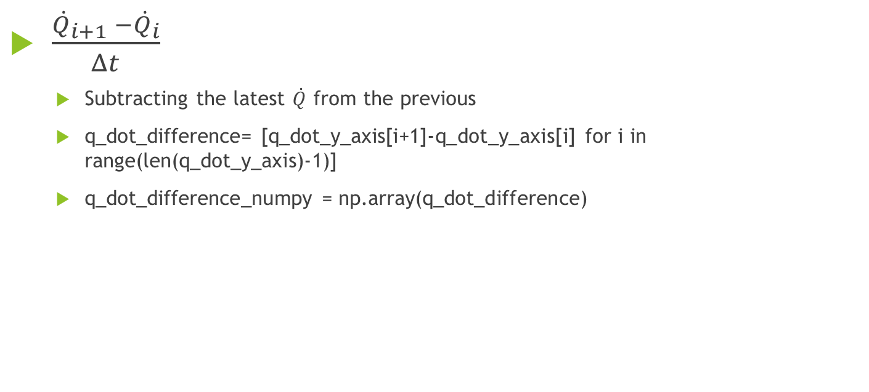
$\frac{{\dot{Q}}_{i+1} −{\dot{Q}}_{i}}{Δt}$
Subtracting the latest $\dot{Q}$ from the previous
q_dot_difference= [q_dot_y_axis[i+1]-q_dot_y_axis[i] for i in range(len(q_dot_y_axis)-1)]
q_dot_difference_numpy = np.array(q_dot_difference)

Slide 6
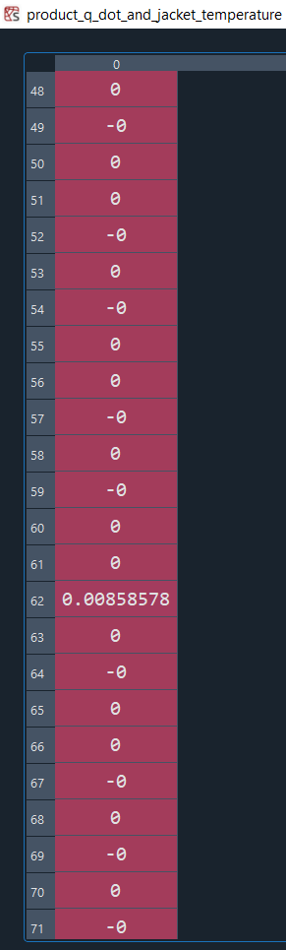

Product of the $\frac{{\dot{Q}}_{i+1} −{\dot{Q}}_{i}}{Δt}$with $\frac{T_{i+1} −T_{i}}{Δt}$
product_q_dot_and_jacket_temperature = np.multiply(q_dot_difference_numpy,jacket_temperature_difference_numpy)

Slide 7
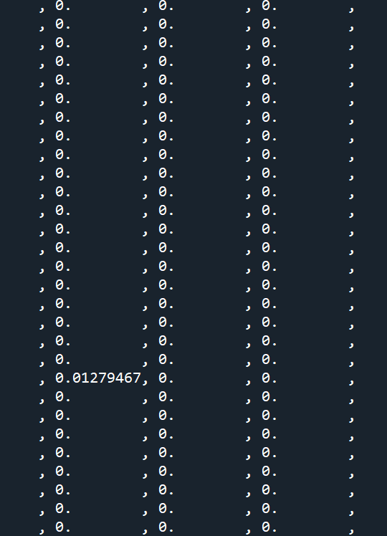

ReLU of the Product of the $\frac{{\dot{Q}}_{i+1} −{\dot{Q}}_{i}}{Δt}$with $\frac{T_{i+1} −T_{i}}{Δt}$
loss_experiment = tf.nn.relu(-product_q_dot_and_jacket_temperature)

Slide 8


Reduce Sum of ReLU of the Product of the $\frac{{\dot{Q}}_{i+1} −{\dot{Q}}_{i}}{Δt}$with $\frac{T_{i+1} −T_{i}}{Δt}$
loss_experiment_2 = tf.math.reduce_sum(tf.nn.relu(-product_q_dot_and_jacket_temperature))

